Slide 1
1 Million
Gigabytes
300 million
Books
30
Times the Library of Congress
You

Slide 2

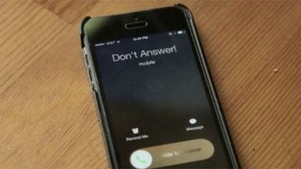
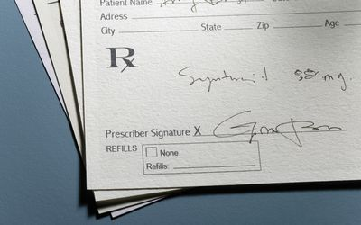

Slide 3
We Have a problem
Notes:
Despite generating a proverbial waterhose of health data, individuals may still find themselves in a drought of information when it comes to essential institutions that are critical to their well-being and that of their nation.
In comes Healthcare Interoperability… Here is the deal , When it comes to a list of nations The US fails to even rank in the countries that are working to establish health interoperability.

Slide 4
HL7, SNOMED CT, LONIC , ICD ,CPT ,DICOM.
DHS
Data leak
Cost
Accountability
Incentivising
Notes:
-These are just a small common Forms of health data that is used to define your visit to your doctor or specialist at any given time.
Imagine being asked a question english being expected to answer in four languages that nobody speaks. Well that is the challenge HCP, insurance companies and federal health institutions face daily.
- Policy and regulations in place protect Patient data , but what does that really mean , how can policy makers create a synthax for a language they don't even speak .
- What good is your hippa law when you don't really understand what you are really protecting.
- Security of data is important and crucial to efficacy of data in its exchange .

Slide 5
Background
HIPPA laws
Minnesota’s Department of Human Services.
Notes:
, every individual is entitled to their personal health information
2) is working to develop different tools that allow individuals to easily access their health data.

Slide 6



Issues with Existing Health Apps
Blue Cross Blue Shield
My Chart
1
My-Privia Patient Portal
Ambiguous information
Complex Interface
Not enough information
Not user friendly
Bugs
Not enough user information
Information not digestible

Slide 7
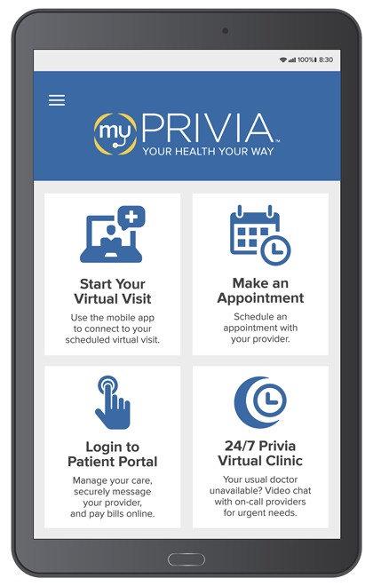
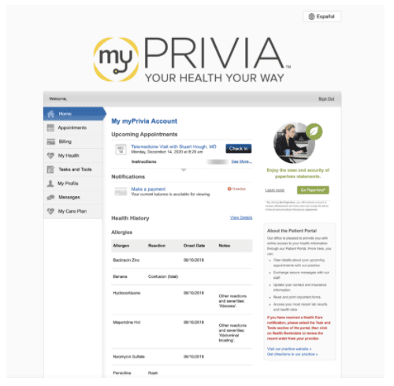
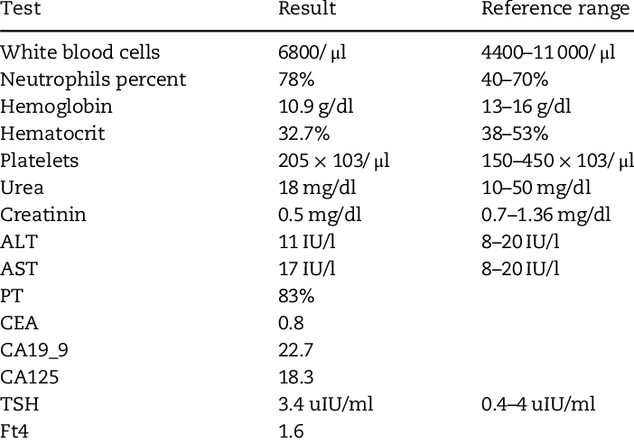
What is already on the Market?
Blue Cross Blue Shield
EPIC Health
MyChart
my-Privia Patient Portal
Accenture Federal Services
Cerner Corporation
Notes:
Health care providers and insurance companies ensure that every patient has access to their personal information in regards to their health.

Slide 8
UX
Use cases, user stories, notes to set up the wireframes. Such as…
“As an Administrator, I would like to restrict permissions based on role.”
“As a Moderator, I would like to flag and approve comments.”
Executives indicated that being able to see a summary of each segment of data was their #1 priority.
Note: secondary admin workflow not planned for this release.

Slide 9
What Now ?

Slide 10
Proposed Solutions
Design
Benefit
Empowerment
Data standardization
Interconnectivity
Convenience
policy and accountability
API support.
Notes:
Design a User Friendly Interface that allows easy access to user information
Benefit the user in what information is given
Data standardization is how we create a standard method of creating, sharing and securing data
Interconnectivity: to what extent can our health care data go so we, our community, our state, and our region can benefit from it.
Convenience entails user experience and how the user will interact effectively with the interface
Policy and Accountability to us means ensuring both user and policy maker completely secure data transition
API support: Whats the feasibility of implementing API support under the design perspective of this challange

Slide 11
Patient’s Perspective

Slide 12
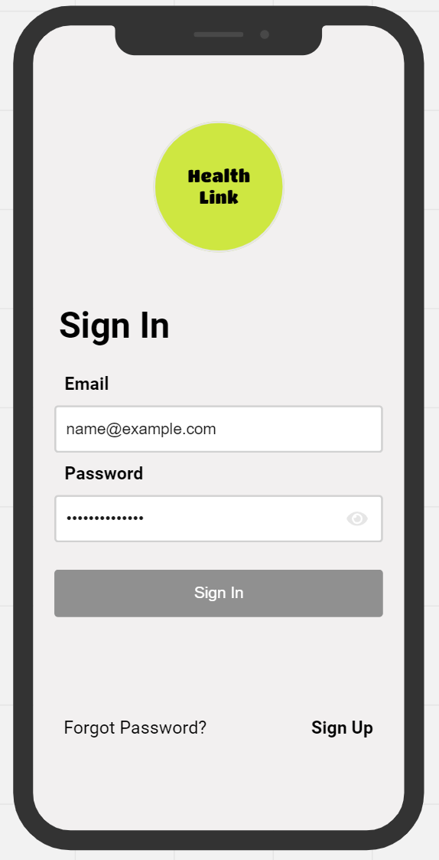
Let’s Take A Look

Slide 13
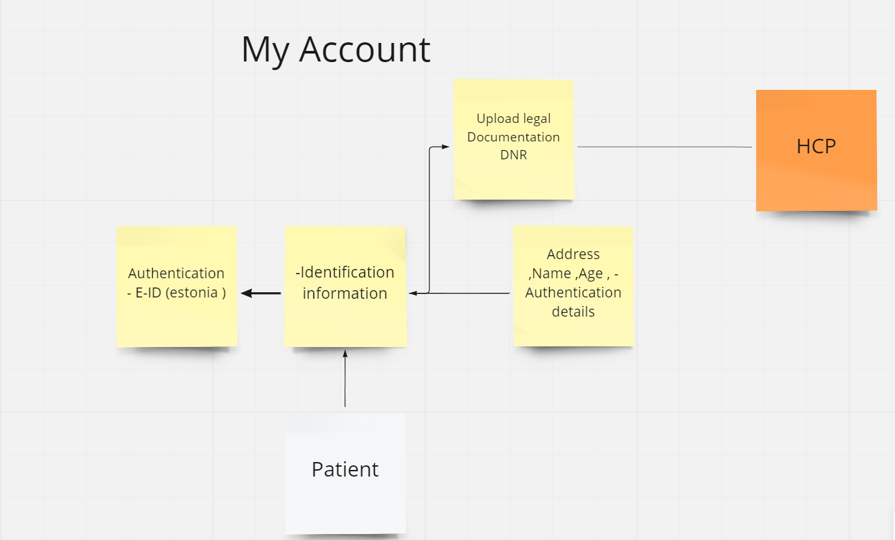
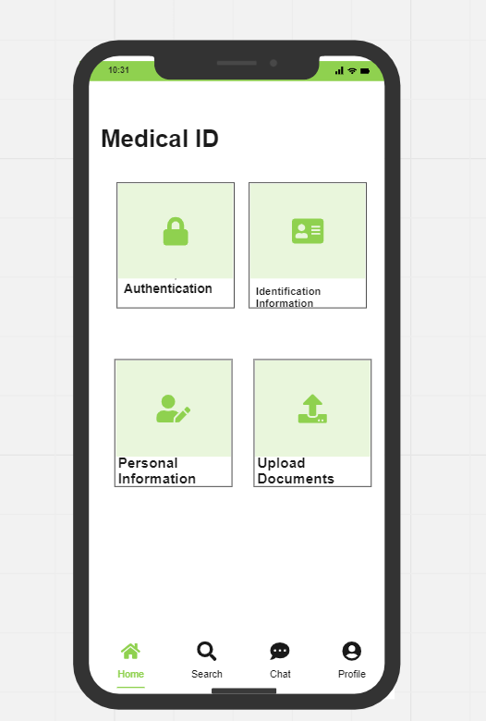
Security Authentication
Notes:
Fatma ) In addition to these modes of authentication, every design choice that we went forward with we put a lot of intention for it to be interoperable. Of course, we cant overlook the security authentication or the log in factor of our interface
Just like our medical records, our log in data is useful to tracking variety factors such as frequency in which a user logs into their interface. Ranking the top 10 healthcare interoperability friendly nations the US fails to make the rank. Of course can attribute this to the fact that there is no uniform health system. So the question becomes how do we create such uniformity in an institution that does not support it, comes in EID.

Slide 14
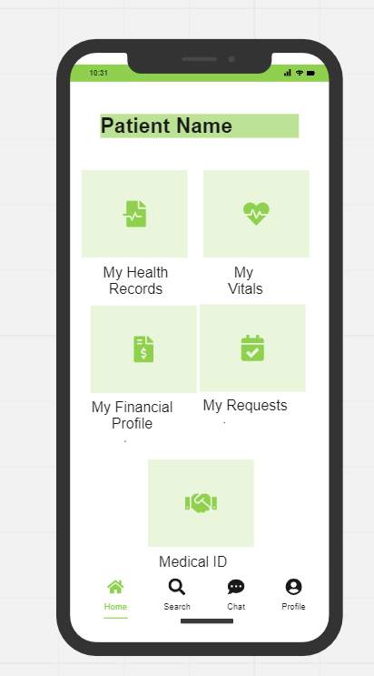
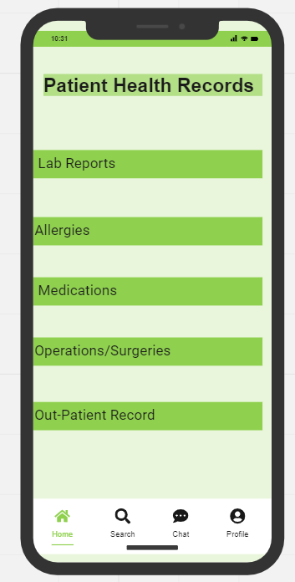
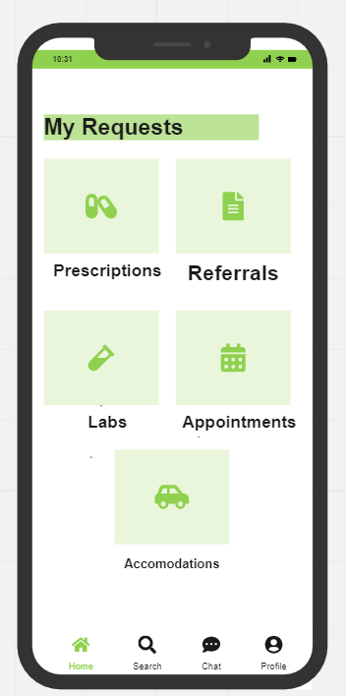
Patient View of Home Page

Slide 15

Data Standardization
Too many options
Notes:
When it comes to your Health Records , While beginning with you and your HCP the extent of where it reaches goes beyond your knowledge , yes even with HiPPA regulations . Our challenge here is how do we approach this from a user Centic perspective how do we promote data standardization though the lens of interconnectivity , convenience , accountability , and policy..

Slide 16
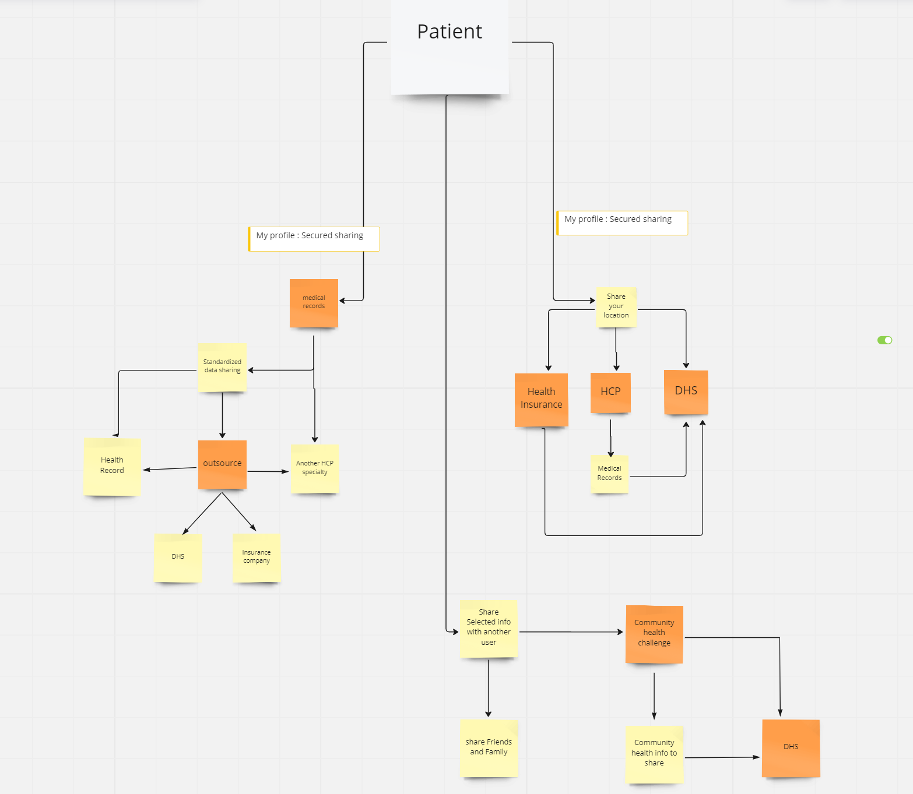

Slide 17
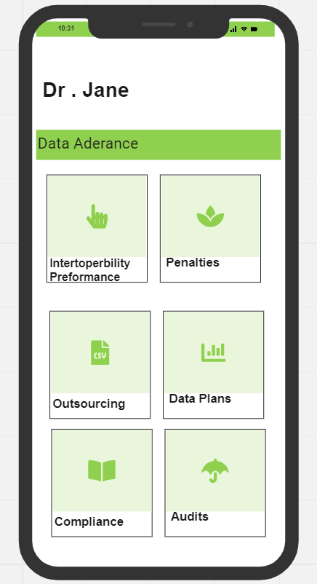
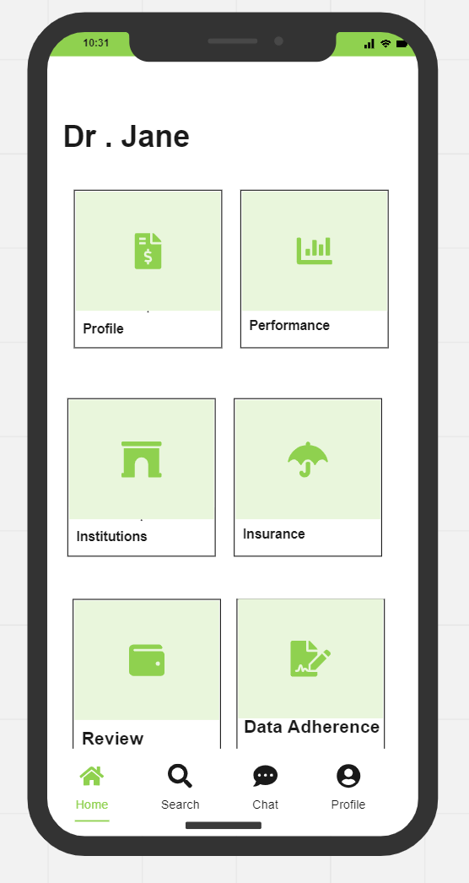
Healthcare Provider View

Slide 18
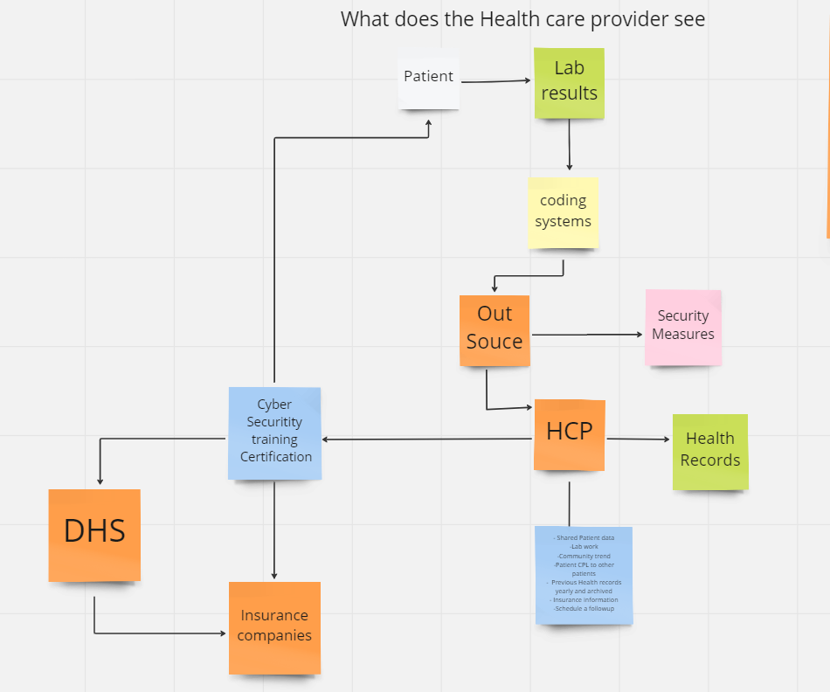
Health Care Provider View
Notes:
ChallengeHCP faces.
- Data Standardization
> coding systems , communication protocols, integrating patient data across different systems.
- Data security
> Exchange between different health systems and organizations Security Concerns .
-Compatibility
>Healthcare systems compatibility API (tech platforms , communication protocols ,data formats )
-HIPPA Regulations
-cost Interoperability
>Shared costs
-Resistance to change
On healthy

Slide 19
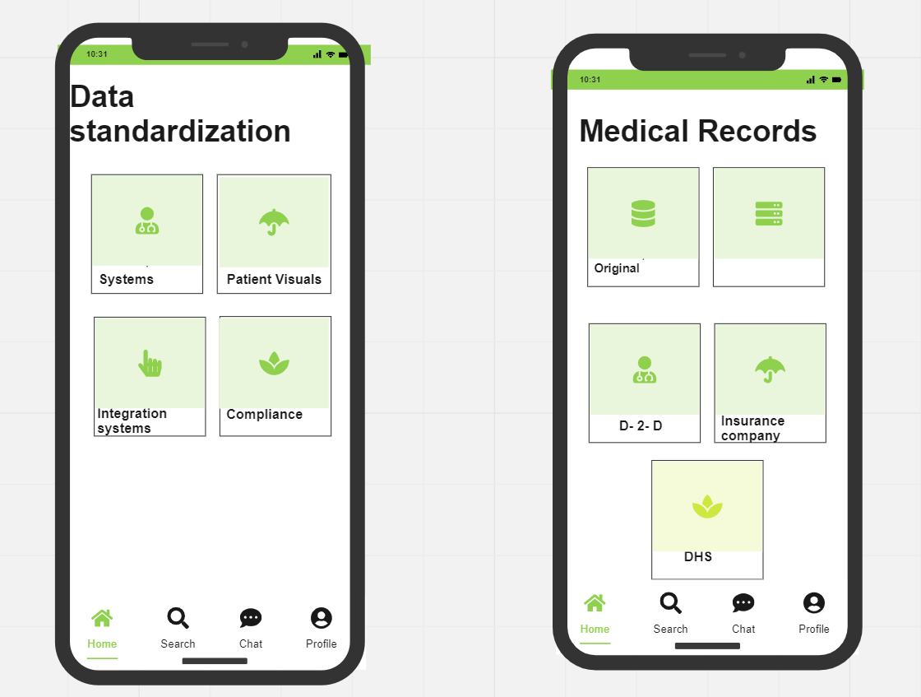

Slide 20
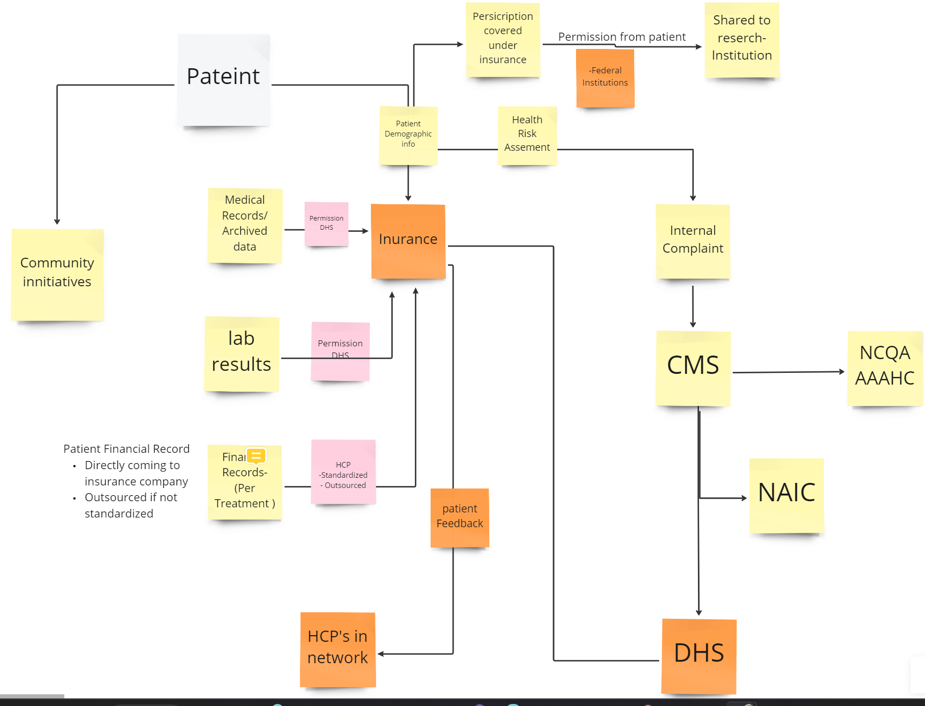

Slide 21
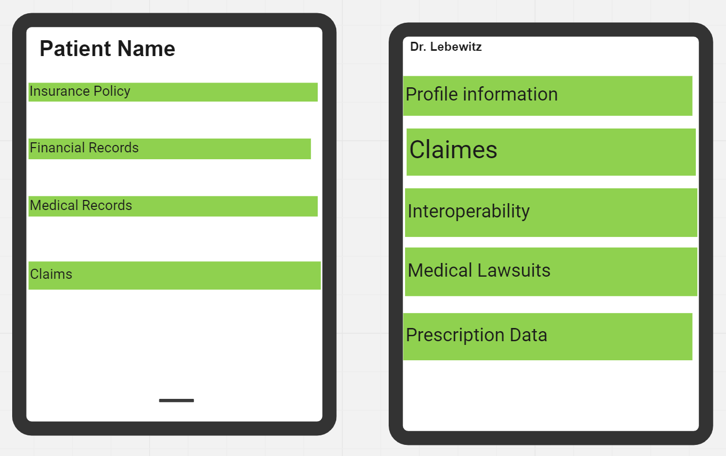
Ensuring the Insurance

Slide 22
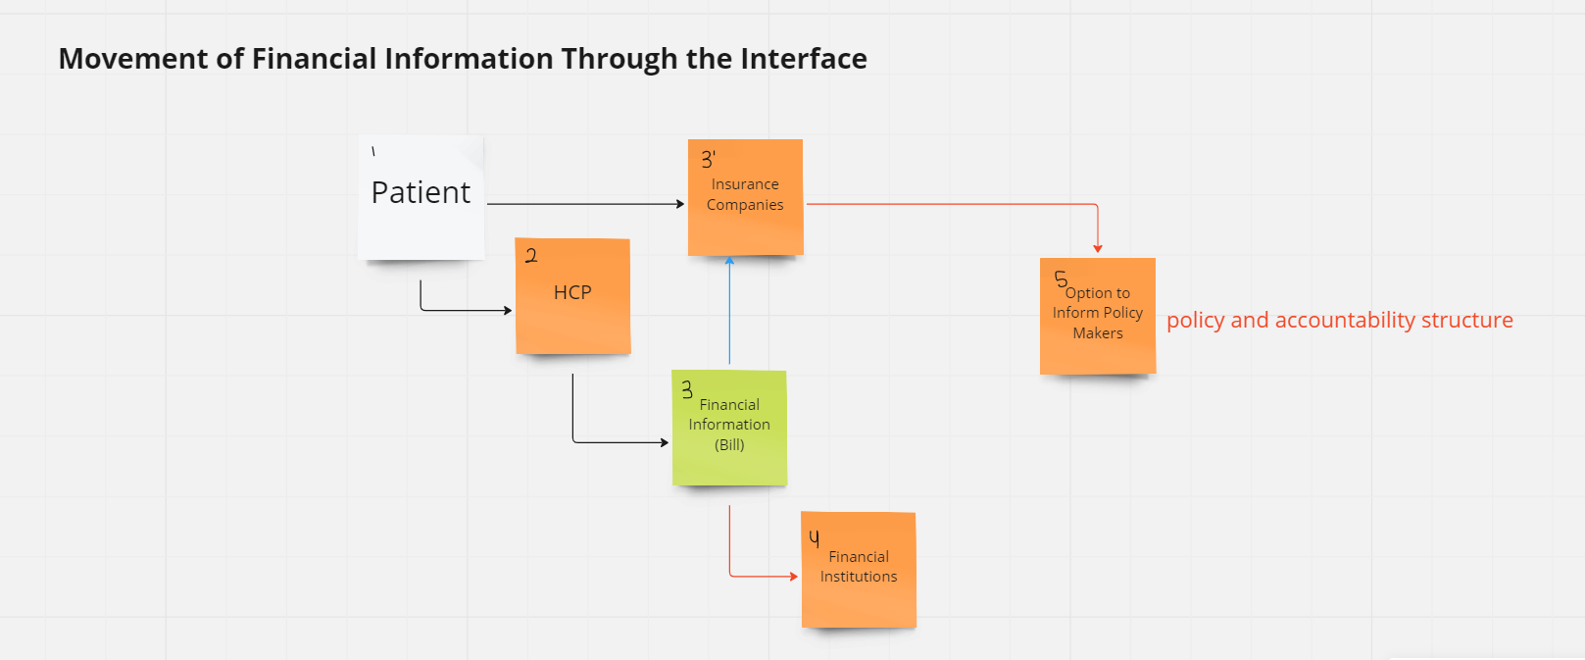


Slide 23
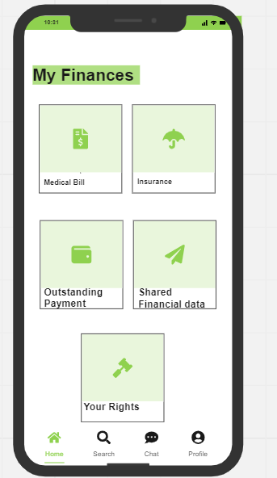
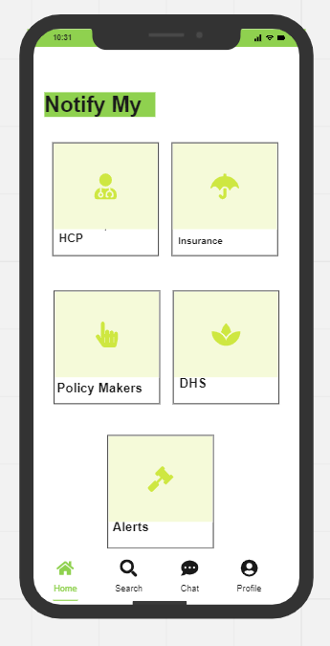
The Cost of Health

Slide 24
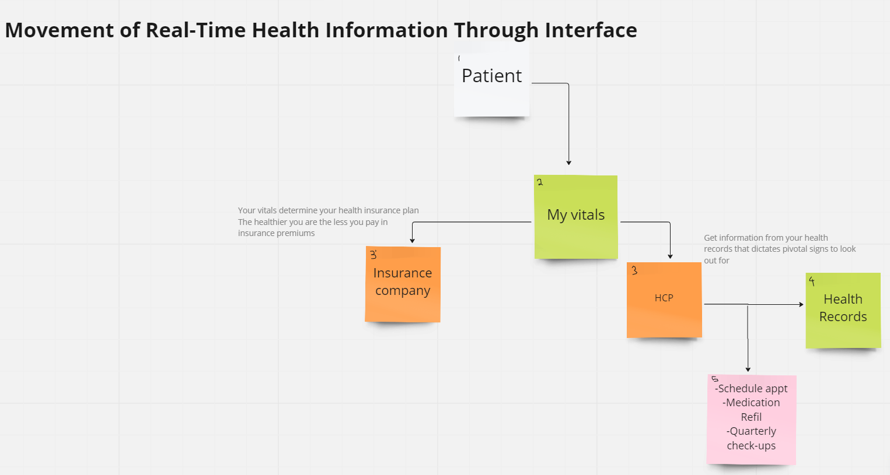

Slide 25
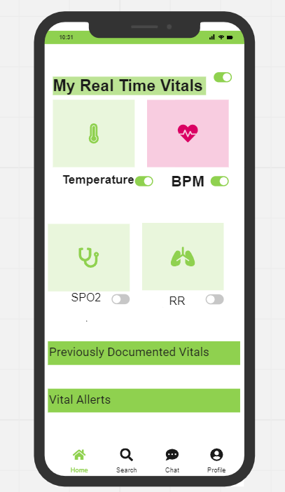
We’re also tech friendly !
Notes:
Options of Connected Health Devices
Fit Bit
Smart Watch
Smart Car

Slide 26
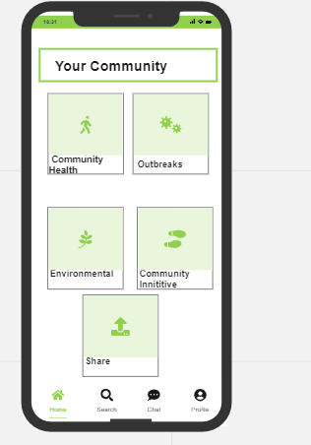
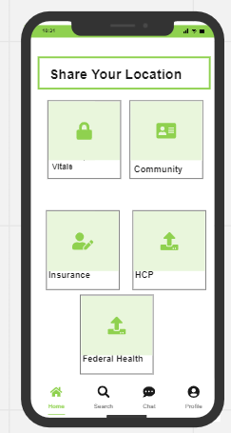
It takes a village….

Slide 27
Were only human

